Slide 1
Chapter 5
Data Link Layer

Slide 2
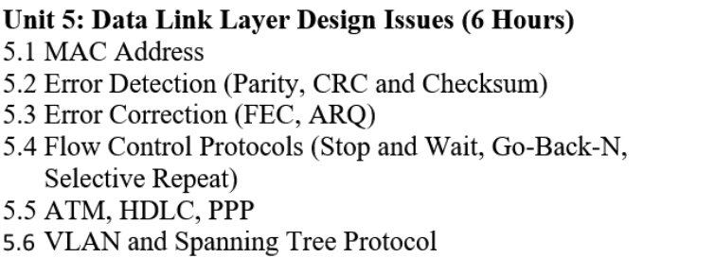
Contain

Slide 3
Data-Link Layer
The “Data-Link layer,” is responsible for maintaining and terminating the established connection between the network devices over the network channel.
The Data-Link Layer has two sublayers:
The first is the “medium access control,” which uses the MAC addresses from the network devices to transmit data between them.
The second layer is the “logical link layer,” which identifies, checks flow control, and performs the error check for the transmitted data.

Slide 4
Working Of the Data-Link Layer
The data flow between the data-link layer and other layers in the OSI Model, i.e., to begin with, the network layer will share the data packets with the data-link layer.
The data-link layer handles these data packets by integrating them with the frame structure.
The frame acts as a header for the data packet, containing information about the destination address, sender address, and other related services.
The final data format in the data-link layer is known as the data frame, which is then transmitted to the physical layer of the OSI Model.

Slide 5
Functions of the Data-Link Layer
The working of the data-link layer in the OSI model requires the need functioning of the following attributes:
1. Framing
The data packets received from the network layer are encapsulated in frames by the data-link layer for bit-to-bit sharing over the channel.
It is also responsible for restructuring the framed data in the network model, and each data frame is different from the others.
2. Addressing
The task of adding a physical address to the frame in the header format is known as addressing.
It acts as an identification service for transmitting the frames to multiple network models over t

Slide 6
3. Flow Control
During data transmission, the sender or receiver's data flow may differ, causing network traffic in the channel.
The Data-link layer in such situations acts as a flow control for the sender side to prevent data overflow at the receiver side.
4. Access Control
In this network model, when multiple devices share the same communication channel, this leads to data collision in the network channel.
To prevent such data collision, the data-link layer performs checks on the devices with the same network channel to avoid data loss.
5. Error Control
During data transmission, due to noise or signal loss, errors might occur in the data being transmitted.
To minimize such data error rate, the data-link layer performs error detection and correction techniques on the transmitted data.

Slide 7
Sub-Layers of the Data-Link Layer
The data-link layer depending on the communication with the other OSI model is divided into two types of sub-layers:
1. Logical Link Control (LLC)
This is the upper sub-layer of the data-link layer.
The LLC sub-layer is responsible for handling and maintaining the communication between the other layers of the OSI Model.
It is also responsible for handling error messages and reliability checks for the data.
2. Media Access Control (MAC)
This is the lower sub-layer of the data-link layer.
The MAC sub-layer is responsible for framing the data received from the upper layers.
It also is responsible for data encapsulation and media access control for the data received.

Slide 8
Error Detection and Correction in Computer
Error detection methods are used to check whether the receiver has received correct data or corrupted data.
And error correction is used to correct the detected errors during the transmission of data from sender to receiver.
Errors in Communication
When the information received at the receiver end does not match the sent data.
At the time of transmission, errors are introduced into the binary data sent from the sender to the receiver due to noise during transmission.
This means that a bit having a 0 value can change to 1 and a bit having a 1 value can change to 0.

Slide 9
Common techniques include
Parity Check,
Checksum, and
Cyclic Redundancy Check (CRC)
Numerical approach

Slide 10
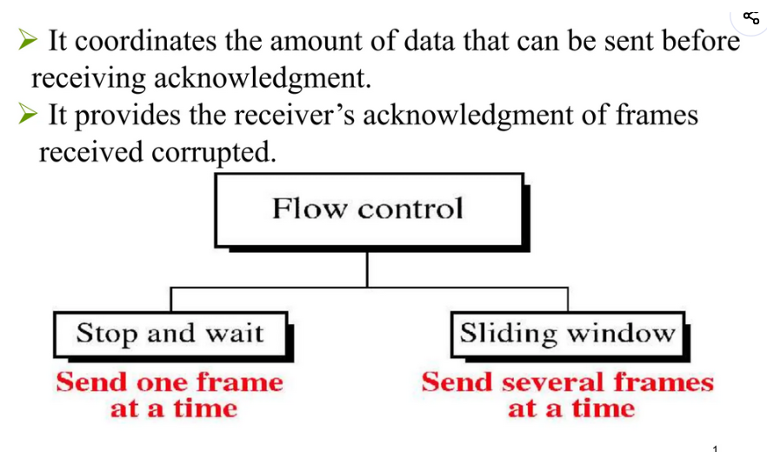
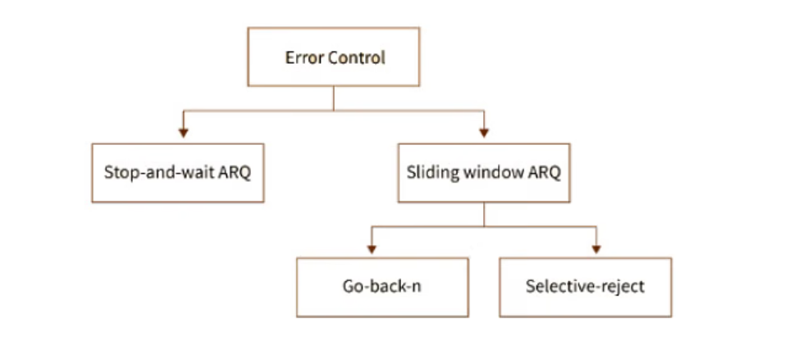

Slide 11
MAC (Media Access Control) Address
MAC Addresses are unique 48-bit hardware numbers of a computer that are embedded into a network card (known as a Network Interface Card) during manufacturing.
The MAC Address is also known as the Physical Address of a network device.
In the IEEE 802 standard, the data link layer is divided into two sublayers:
Logical Link Control (LLC) Sublayer
Media Access Control (MAC) Sublayer
The MAC address is used by the Media Access Control (MAC) sublayer of the Data-Link Layer.
MAC Address is worldwide unique since millions of network devices exist and we need to uniquely identify each.
A MAC address uniquely identifies network interfaces.

Slide 12
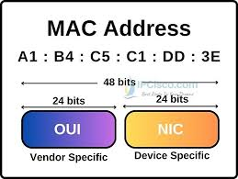
Format of MAC Address
To understand what is MAC address is, it is very important that first you understand the format of the MAC Address.
So a MAC Address is a 12-digit hexadecimal number (48-bit binary number), which is mostly represented by Colon-Hexadecimal notation.
The First 6 digits (say 00:40:96) of the MAC Address identify the manufacturer, called the OUI (Organizational Unique Identifier).
IEEE Registration Authority Committee assigns these MAC prefixes to its registered vendors.

Slide 13
Asynchronous Transfer Mode (ATM):
It is an International Telecommunication Union- Telecommunications Standards Section (ITU-T).
Efficient for call relay and it transmits all information including multiple service types such as data, video, or voice .
Which is conveyed in small fixed-size packets called cells.
Cells are transmitted asynchronously and the network is connection-oriented.

Slide 14
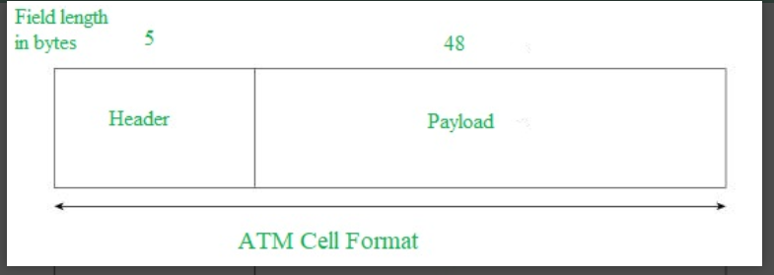
ATM Cell Format -
ATM is a technology that has some event in the development of broadband ISDN in the 1970s and 1980s, which can be considered an evolution of packet switching.
As information is transmitted in ATM in the form of fixed-size units called cells.
Each cell is 53 bytes long - 5 bytes header and 48 bytes payload.
Making an ATM call requires first sending a message to set up a connection.

Slide 15
Working of ATM: ATM standard uses two types of connections. i.e., Virtual path connections (VPCs) which consist of Virtual channel connections (VCCs) bundled together which is a basic unit carrying a single stream of cells from user to user.
A virtual path can be created end-to-end across an ATM network, as it does not rout the cells to a particular virtual circuit.
In case of major failure, all cells belonging to a particular virtual path are routed the same way through the ATM network, thus helping in faster recovery. Switches connected to subscribers use both VPIs and VCIs to switch the cells which are Virtual Path and Virtual Connection switches that can have different virtual channel connections between them, serving the purpose of creating a virtual trunk between the switches which can be handled as a single entity.
Its basic operation is straightforward by looking up the connection value in the local translation table determining the outgoing port of the connection and the new VPI/VCI value of connection on that link

Slide 16
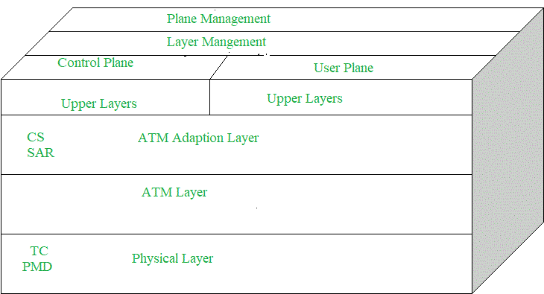
ATM Adaption Layer (AAL) - It is meant for isolating higher-layer protocols from details of ATM processes and prepares for conversion of user data into cells and segments it into 48-byte cell payloads.
AAL protocol excepts transmission from upper-layer services and helps them in mapping applications, e.g., voice, data to ATM cells.

Slide 17
Physical Layer - It manages the medium-dependent transmission and is divided into two parts physical medium-dependent sublayer and transmission convergence sublayer.
The main functions are as follows:
It converts cells into a bitstream.
It controls the transmission and receipt of bits in the physical medium.
It can track the ATM cell boundaries.
Look for the packaging of cells into the appropriate type of frames.
ATM Layer -
It handles transmission, switching, congestion control, cell header processing, sequential delivery, etc., and is responsible for simultaneously sharing the virtual circuits over the physical link known as cell multiplexing and passing cells through an ATM network known as cell relay making use of the VPI and VCI information in the cell header.

Slide 18
ATM Applications:
ATM WANs - It can be used as a WAN to send cells over long distances, a router serving as an end-point between ATM network and other networks, which has two stacks of the protocol.
Multimedia virtual private networks and managed services - It helps in managing ATM, LAN, voice, and video services and is capable of full-service virtual private networking, which includes integrated access to multimedia.
Frame relay backbone - Frame relay services are used as a networking infrastructure for a range of data services and enabling frame-relay ATM service to Internetworking services.

Slide 19
High-Level Data Link Control (HDLC) Encapsulation
High-Level Data Link Control (HDLC) is a bit-oriented, code-transparent, synchronous data link layer protocol.
It is widely used for reliable delivery of data frames over communication links. HDLC provides essential functions such as:
Framing
Data transparency
Error detection and correction
Flow control

Slide 20
HDLC Encapsulation Protocol
Standard HDLC Frame Structure
A standard HDLC frame typically contains six fields:
Start/End Flag – Marks the beginning and end of the frame (01111110).
Address Field – Identifies the secondary station.
Control Field – Used for flow and error control.
Information Field – Carries the actual payload (optional in control frames).
FCS (Frame Check Sequence) – Error detection using CRC.
End Flag – Same as start flag, ensuring frame boundary.

Slide 21
Point-to-Point Protocol (PPP)
Point-to-Point Protocol (PPP) is a Layer 2 WAN protocol that encapsulates network-layer packets for reliable, full-duplex communication over point-to-point links.
Operates at the Data Link Layer (Layer 2)
Used over serial cables, cellular links, and fiber optics
Supports encapsulation of multiple network-layer protocols
Provides full-duplex, bidirectional data transmission
Ensures sequential packet delivery
Uses frames as the basic unit of transmission
Requires 8 bytes for encapsulation overhead

Slide 22
(Virtual Local Area Network)
A VLAN (Virtual Local Area Network) logically segments a single physical network into multiple broadcast domains.
Allowing devices to act as if they're on separate LANs, regardless of physical location, for better security, performance, and management by isolating traffic, reducing broadcast noise, and grouping users by function (like 'Sales' or 'Guests') rather than switches.

Slide 23
How it Works
Logical Grouping: VLANs group devices based on criteria like department, application, or user type, not physical location.
Broadcast Domains: Each VLAN is its own broadcast domain, meaning broadcasts (like ARP requests) stay within that VLAN, preventing them from flooding the entire network.
Tagging: Switches add a VLAN ID (tag) to Ethernet frames, identifying which VLAN the frame belongs to, using standards like IEEE 802.1Q.
Communication: Devices in the same VLAN communicate directly; communication between different VLANs requires a router or Layer 3 switch (Inter-VLAN Routing).

